Slide 1
Project Review
Team : n00b$
PROJECT NAME : Contact Storage
MEMBERS : Abhishekh R V, Ajay S, M Alex Benny, Harikrishnan B, Adhithya A, Bhuvanesh C

Slide 2
OUR Project
Our idea is to create an online contact details storage portal, which can be accessed by logging in with a username and respective password.
Our project consists of six components(as of now) : Login page, sign up page(for new users), forgot password page, code verification window, reset password window and main page(to display contact details).
We will be using React for creating our project.

Slide 3
our Design
As a prototype of our project, we have created a design of our project using Figma.
Tools Used in Figma :
Frame – For creating frames in canvas.
Shape – For drawing dialog and other boxes and buttons.
Color Picker – For coloring the shapes drawn.

Slide 4
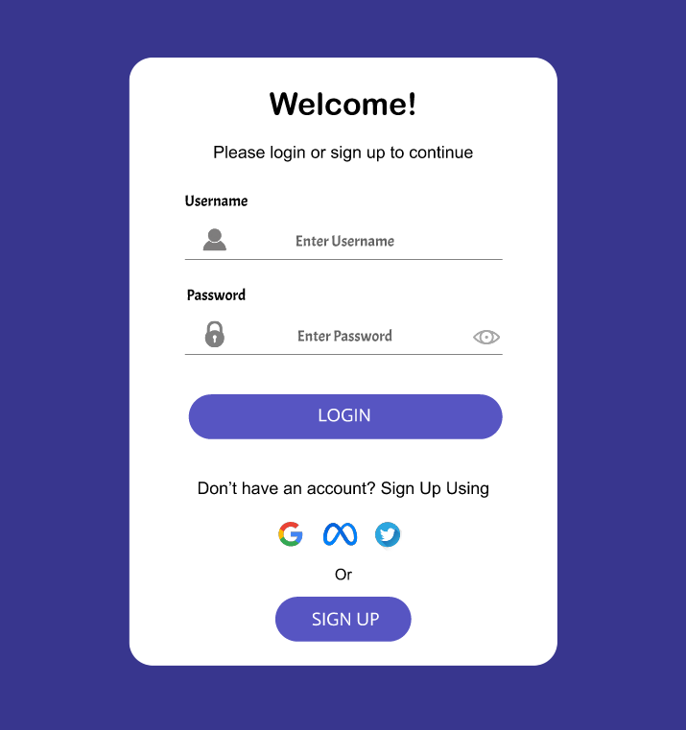
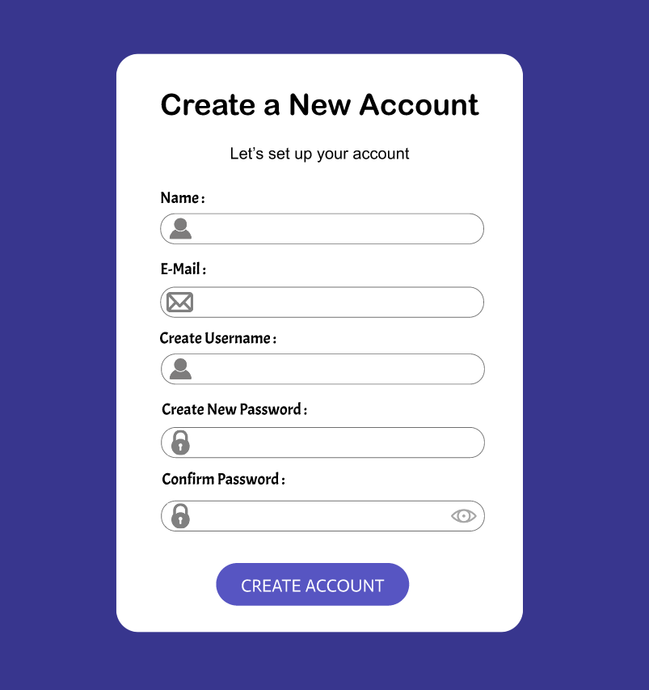
The LOGIN Page AND SIGN UP PAGE

Slide 5
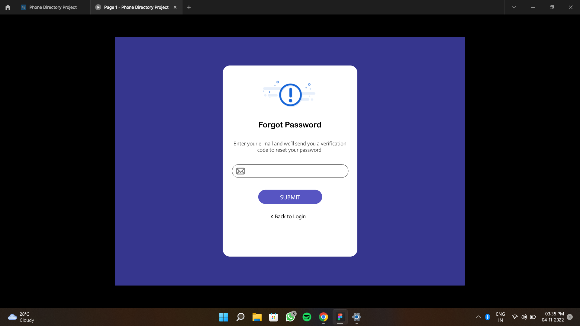
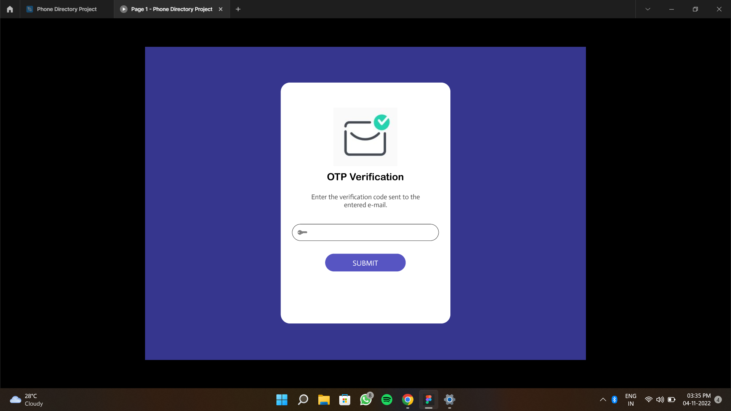
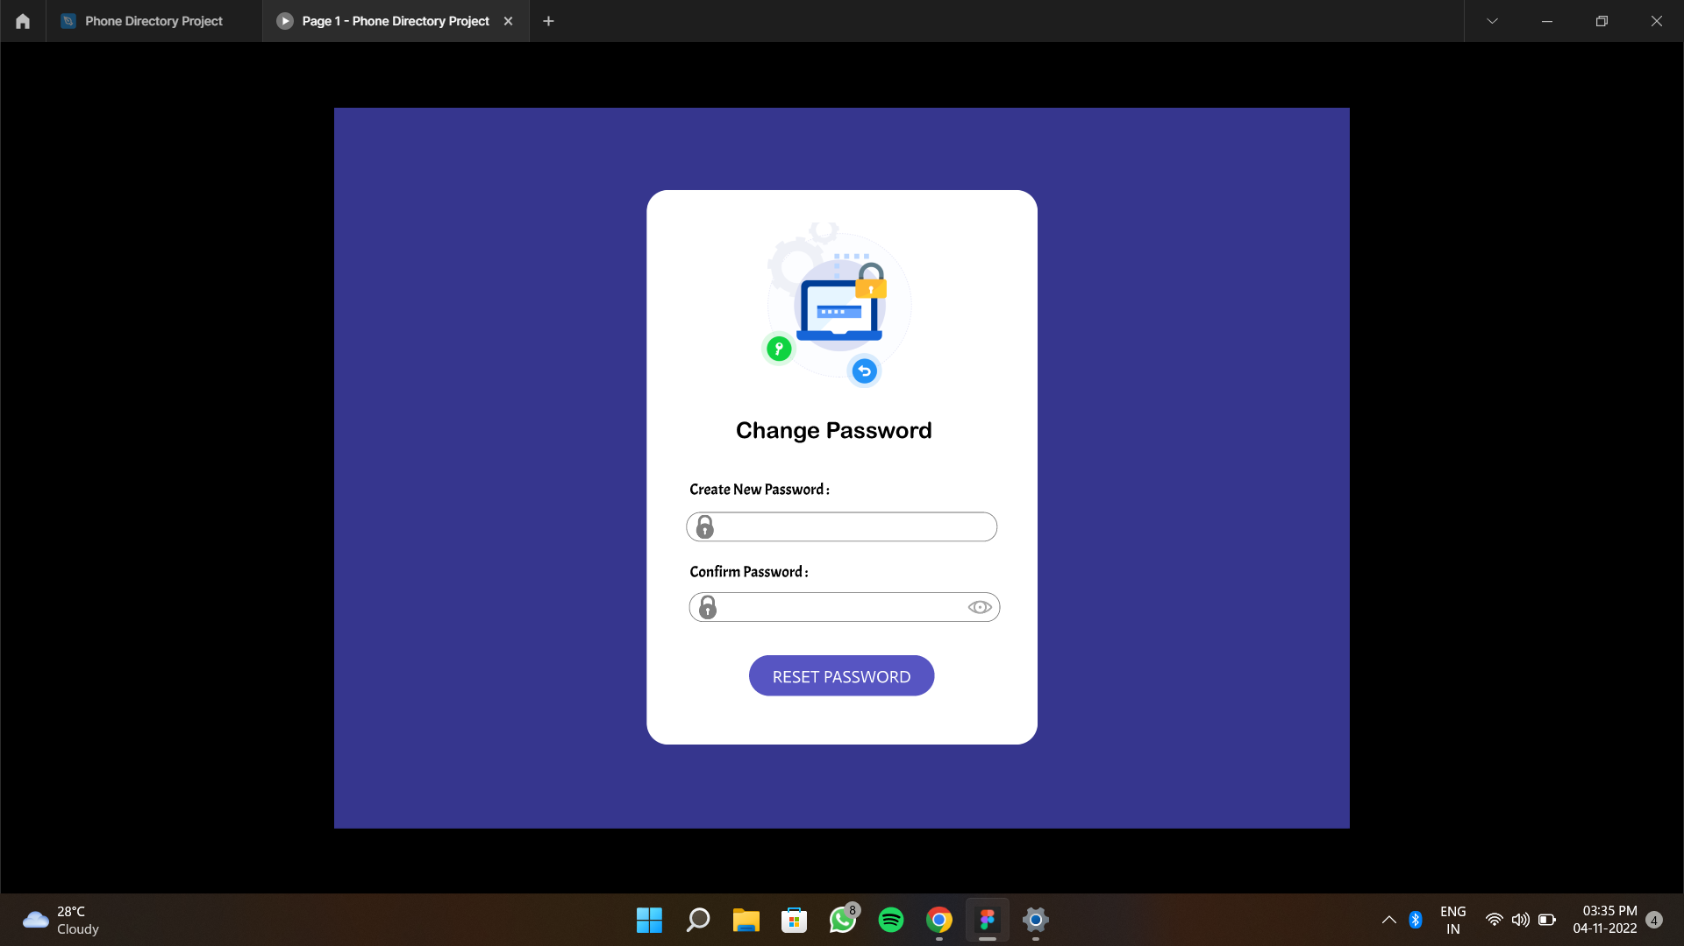
Forget Password Wizard

Slide 6
Forget Password Wizard

Slide 7
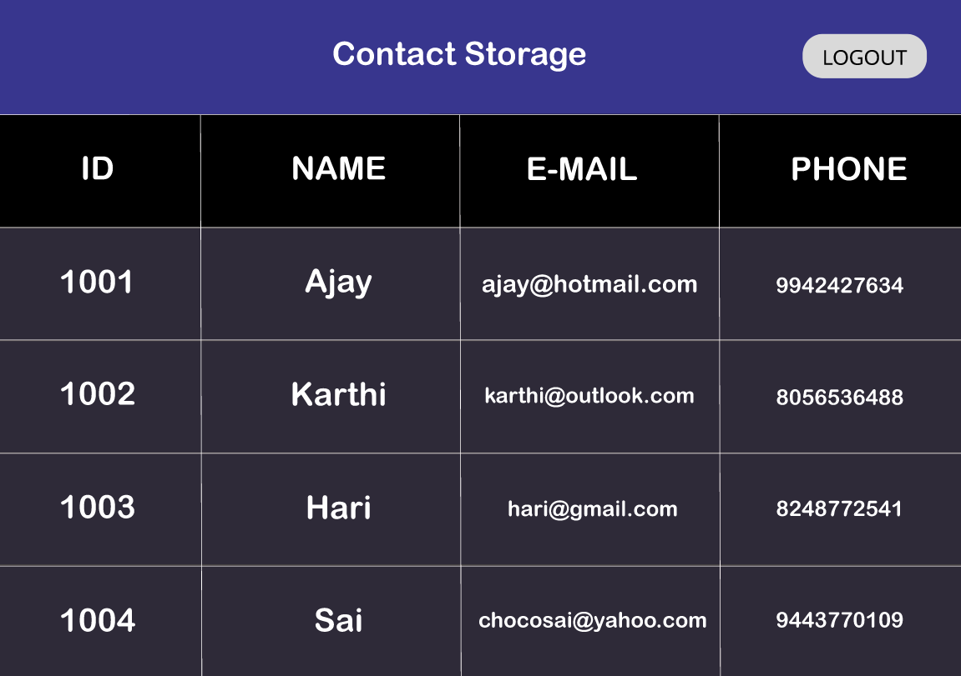
MAIN PAGE

Slide 8
Link to our Figma design:
https://www.figma.com/file/BMIc36c84dpTH0Y9IxoPMc/Phone-Directory-Project?node-id=0%3A1
LINK TO OUR GITHUB REPOSITORY:
https://github.com/ajay-s-2502/Contact-Storage.git
THANK YOU…

